Slide 1

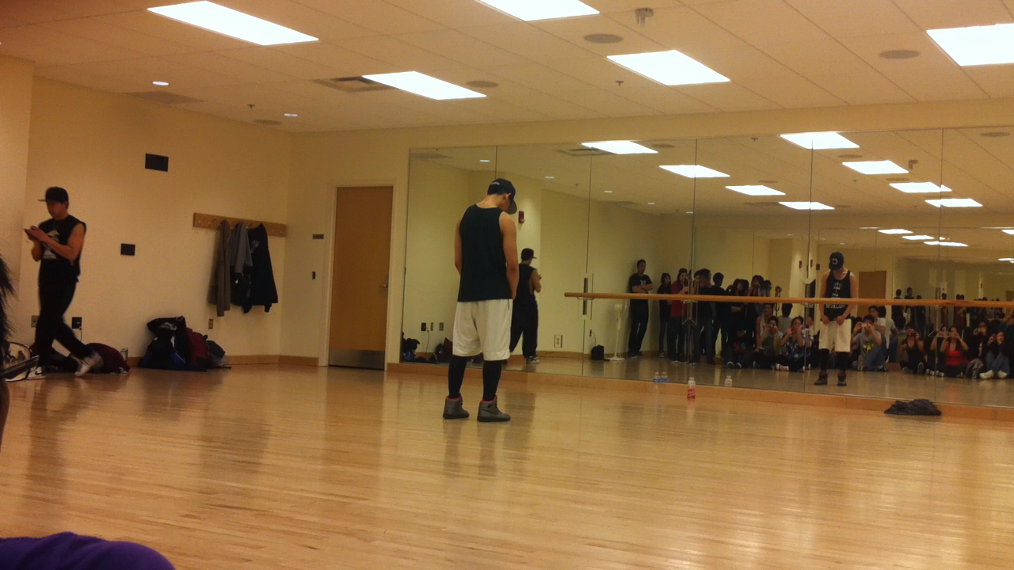
Brian Fucanan of ABDC’s SoReal Cru taught two workshops at the 2011 MAFA Conference at Ohio State. This is eye-catching choreography on Saturday afternoon, March 26.

